Slide 1
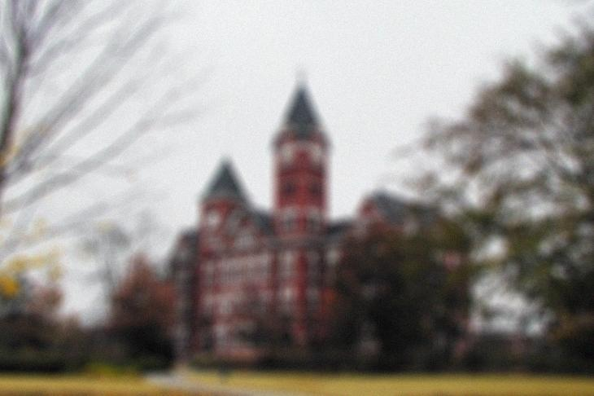

ELEC 7450 Term Project: Iterative Total Variation Deblurring
Spenser Burrows

Slide 2
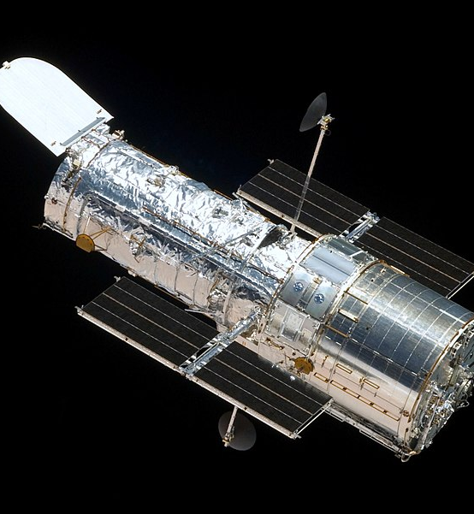
Motivation for deblurring
Blurring effects caused by improperly focused cameras or moving objects/cameras can greatly degrade the quality and usefulness of a digital image
Critical details can be lost due to blurring, and it’s not always possible to just take another picture

Slide 3
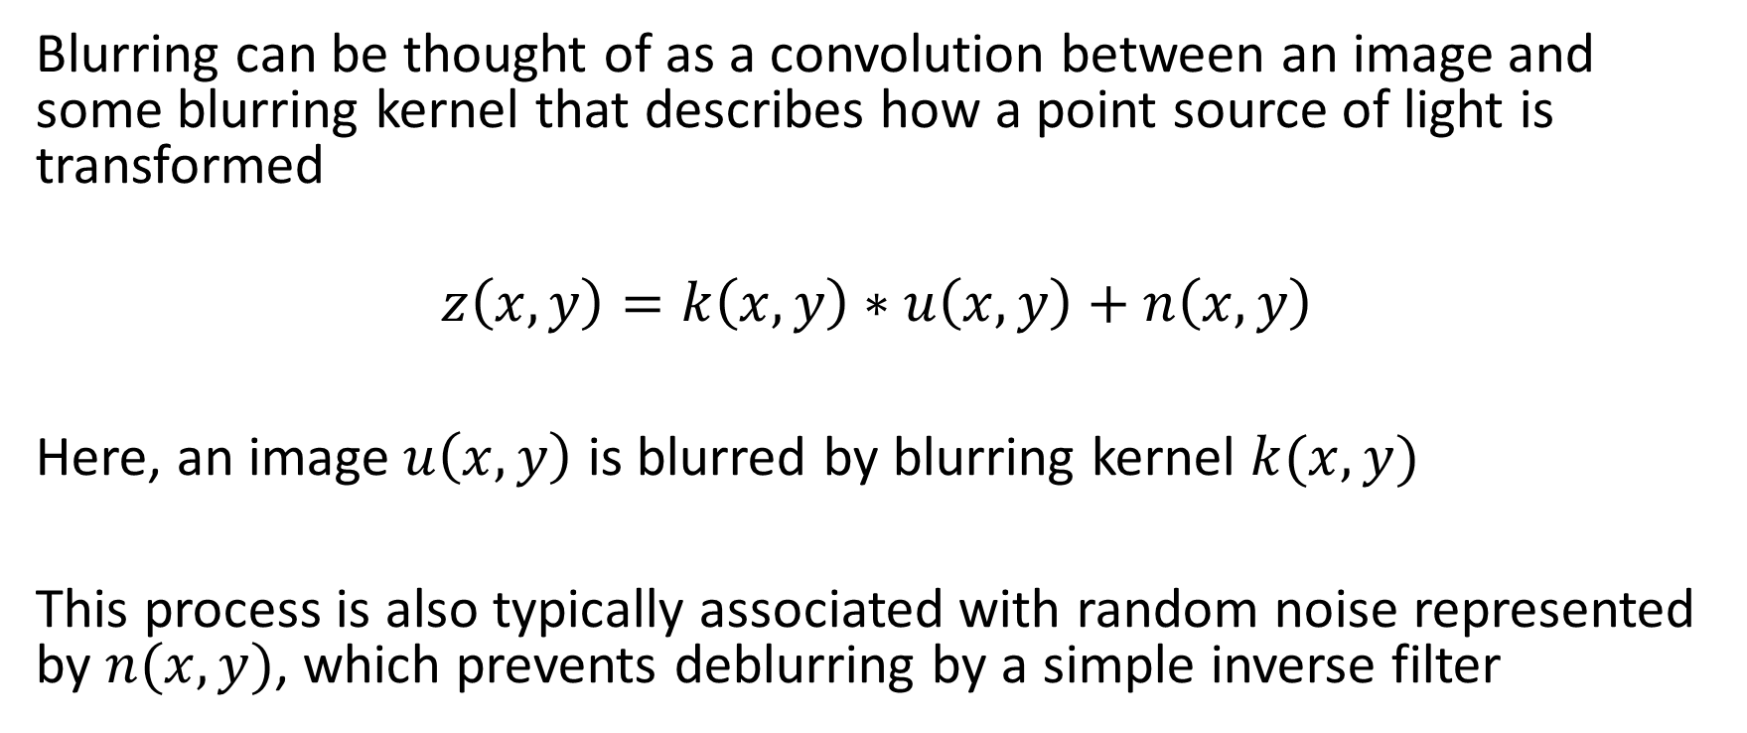
Mathematical description of blurring
Blurring can be thought of as a convolution between an image and some blurring kernel that describes how a point source of light is transformed
$$z\left(x,y\right)=k\left(x,y\right)∗u\left(x,y\right)+n\left(x,y\right)$$
Here, an image $u\left(x,y\right)$ is blurred by blurring kernel $k(x,y)$
This process is also typically associated with random noise represented by $n(x,y)$, which prevents deblurring by a simple inverse filter

Slide 4

Total Variation Regularization
In the early 90s, L. Rudin, S. Osher, and E. Fatemi proposed using an image’s total variation for image denoising, which can be defined as:
$ℴ_{TV}\left[u(x,y)\right]=$ $\int{\left|∇u(x,y)\right|}dxdy$
This can be used to correct for noise while preserving edges
This was soon adapted to the deblurring problem

Slide 5
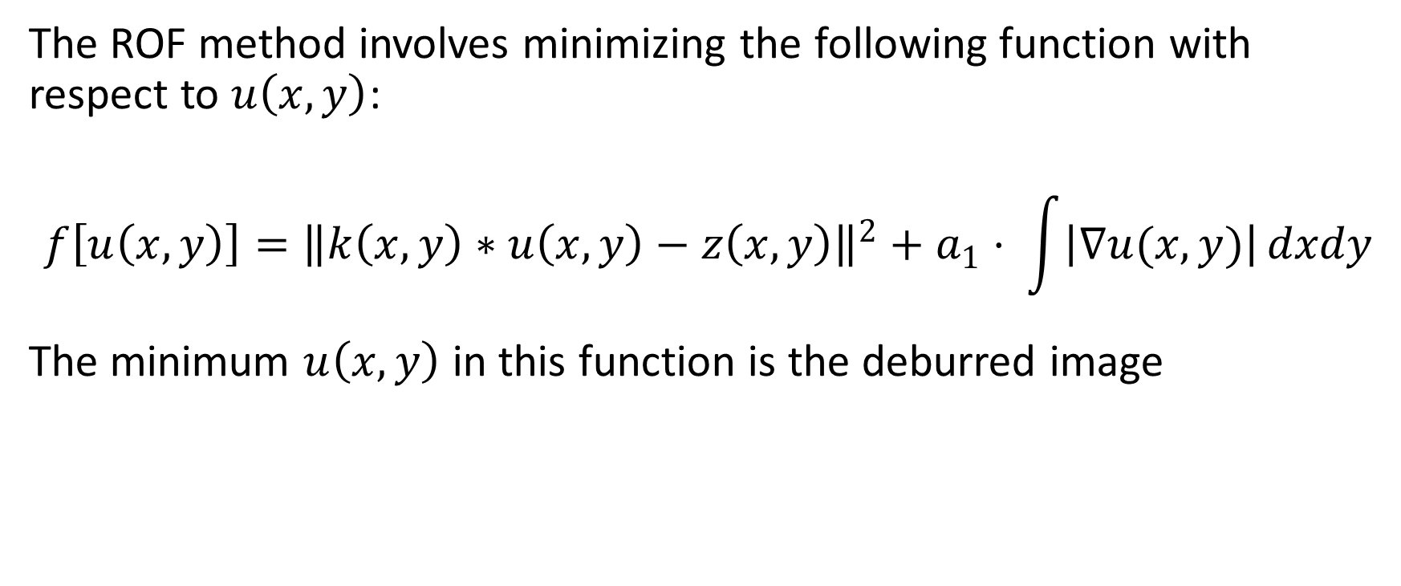
Total Variation Deblurring
The ROF method involves minimizing the following function with respect to $u\left(x,y\right)$:
$$f\left[u\left(x,y\right)\right]={\left\|k\left(x,y\right)∗u\left(x,y\right)−z\left(x,y\right)\right\|}^{2}+a_{1}⋅ \int{\left|∇u(x,y)\right|}dxdy$$
The minimum $u\left(x,y\right)$ in this function is the deburred image

Slide 6
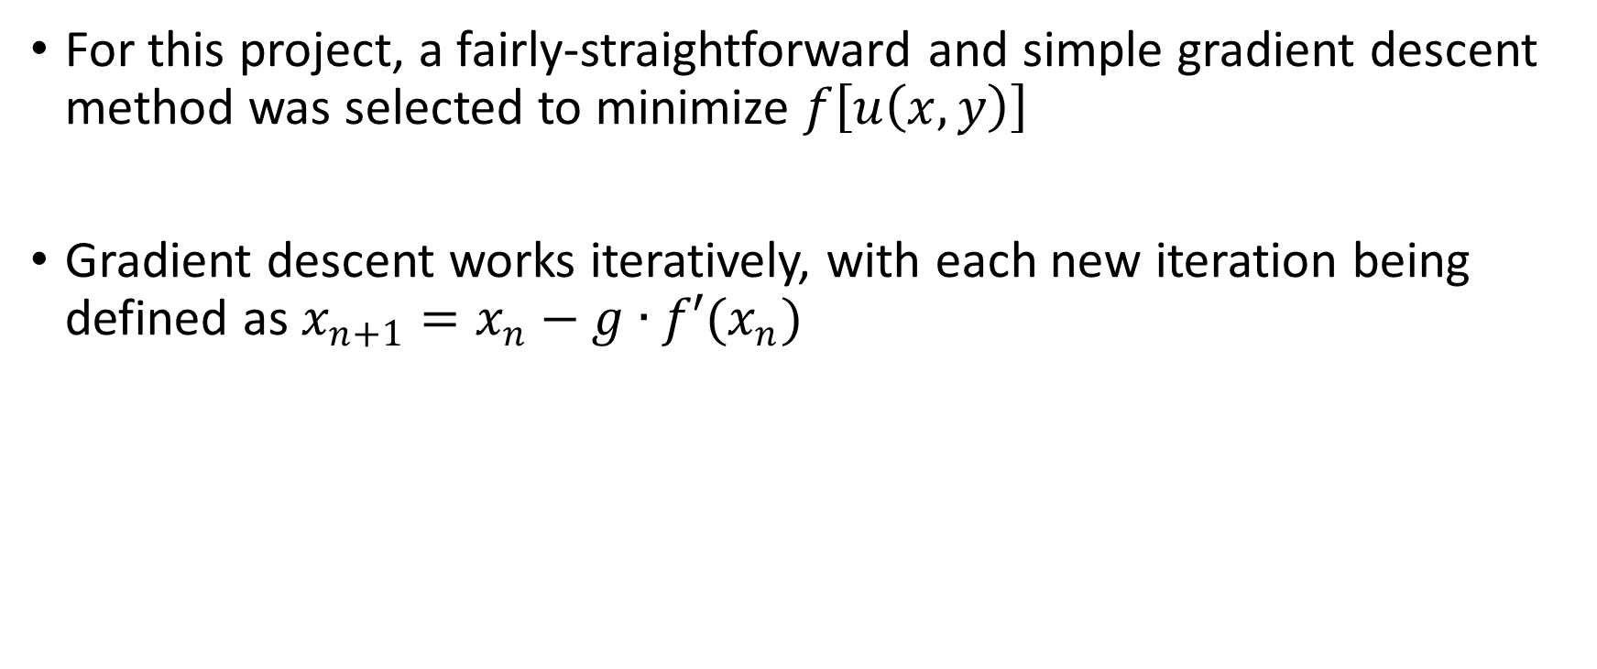
Gradient Descent
For this project, a fairly-straightforward and simple gradient descent method was selected to minimize $f\left[u\left(x,y\right)\right]$
Gradient descent works iteratively, with each new iteration being defined as $x_{n+1}=x_{n}−g∙{f′(x}_{n})$

Slide 7


$$\frac{df\left[u\left(x,y\right)\right]}{du\left(x,y\right)}$$
Each iterative step requires the numerical evaluation of the derivative of the total variation function shown below:
$$\frac{df\left[u\left(x,y\right)\right]}{du\left(x,y\right)}=k\left(−x,−y\right)∗\left[k(x,y)∗u\left(x,y\right)−z\left(x,y\right)\right]−a_{1}\frac{∇^{2}u\left(x,y\right)}{\sqrt{\left|u\left(x,y\right)\right|+ε^{2}}}$$

Slide 8
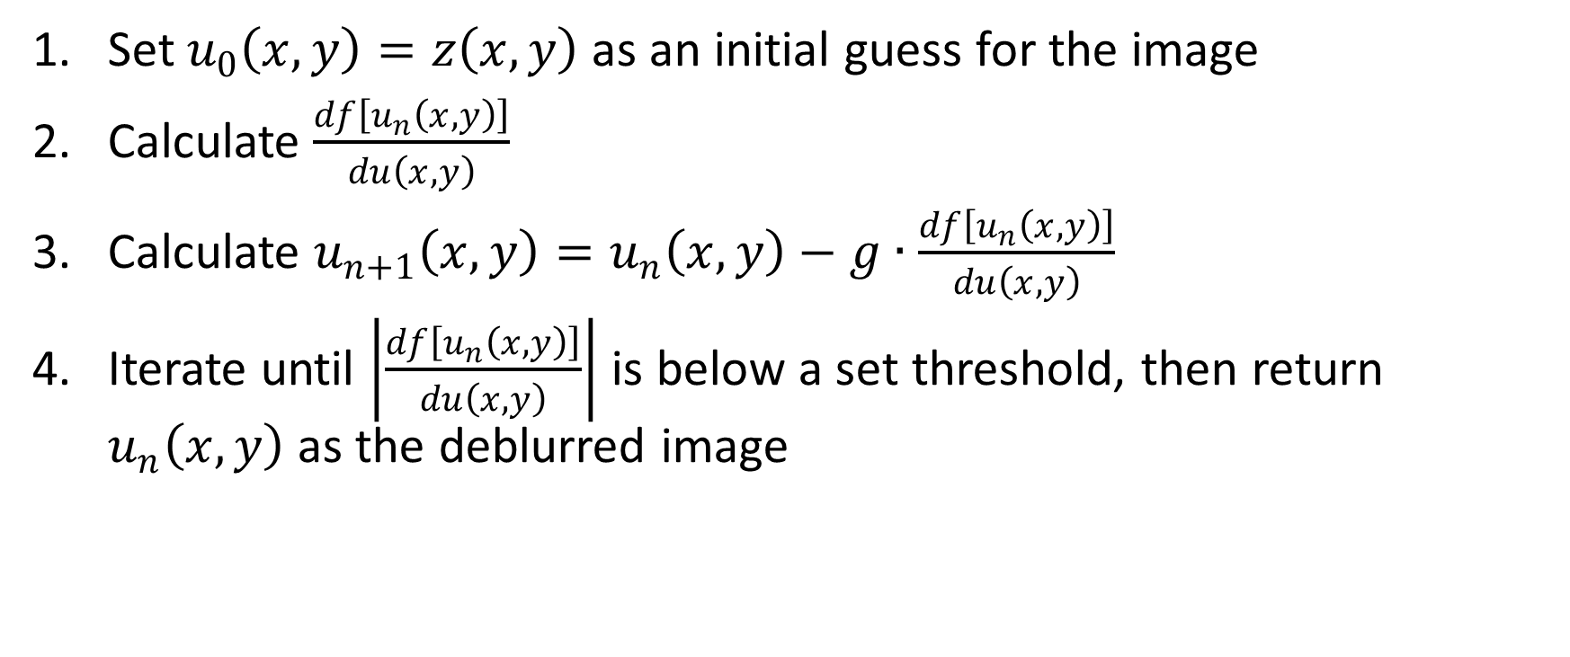
Algorithm
Set $u_{0}\left(x,y\right)=z\left(x,y\right)$as an initial guess for the image
Calculate $\frac{df\left[u_{n}\left(x,y\right)\right]}{du\left(x,y\right)}$
Calculate $u_{n+1}\left(x,y\right)=u_{n}\left(x,y\right)−g∙\frac{df\left[u_{n}\left(x,y\right)\right]}{du\left(x,y\right)}$
Iterate until $\left|\frac{df\left[u_{n}\left(x,y\right)\right]}{du\left(x,y\right)}\right|$ is below a set threshold, then return $u_{n}\left(x,y\right)$ as the deblurred image

Slide 9
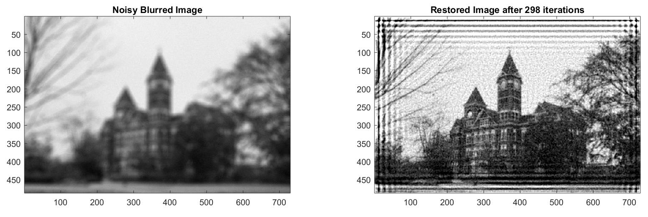
Edge effects
Boundaries of the image can cause distortions due to the abrupt transition between an area with image data and the area outside the image

Slide 10
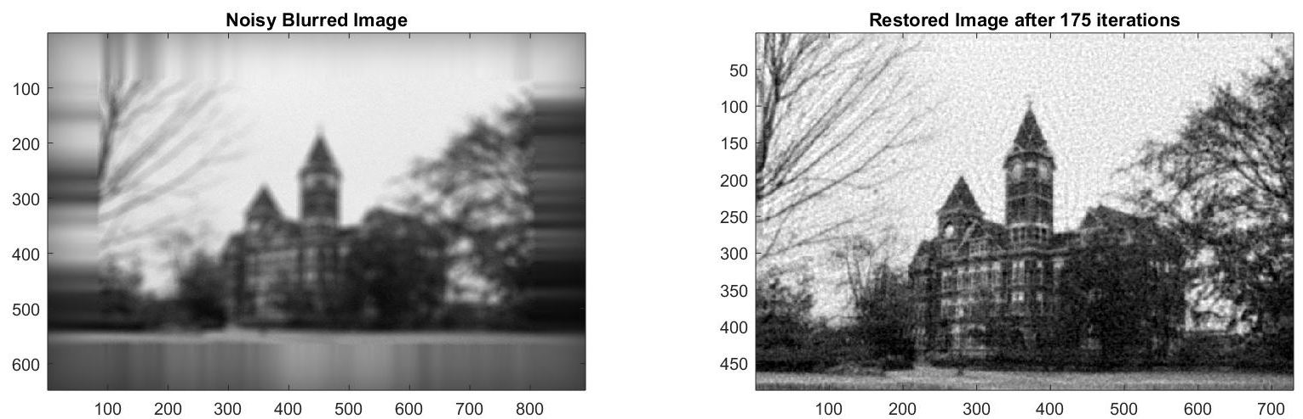
Extrapolating to mitigate effects
Boundary distortions can be addressed by extrapolating the edges of the image out and dimming them gradually

Slide 11
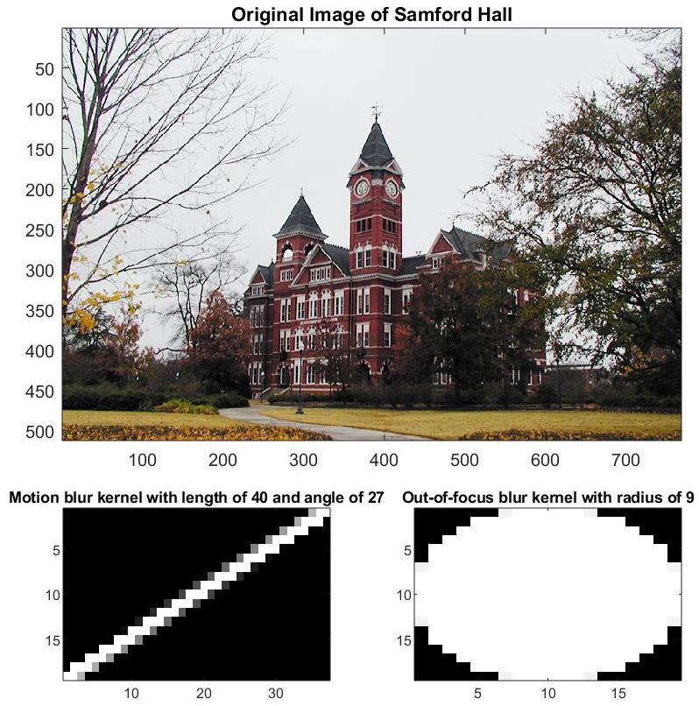
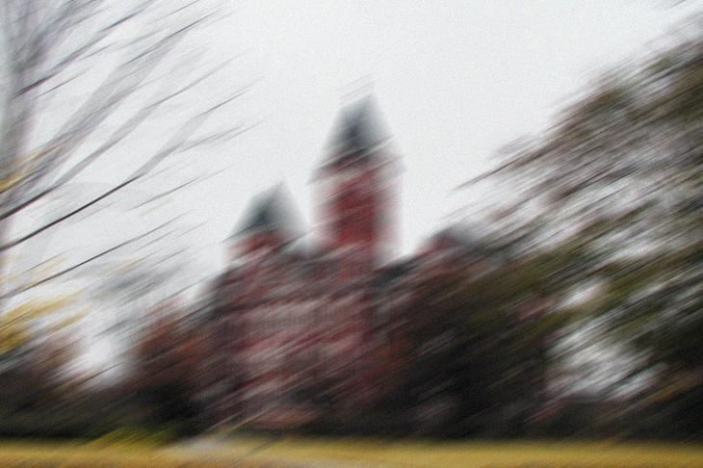
Testing
Known blurring kernels were used to artificially blur test images to evaluate the performance of the deblurring code

Slide 12
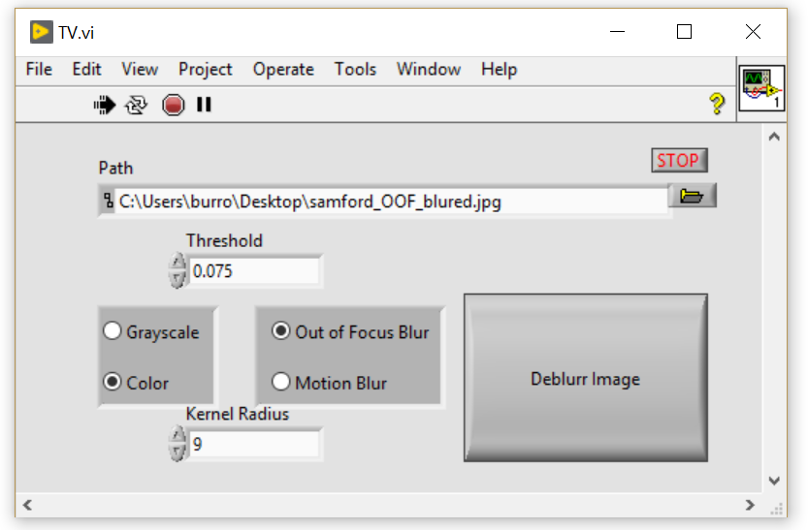
LabVIEW GUI
To provide a user-friendly interface and open the possibility of integration with LabVIEW-controlled hardware, a LabVIEW virtual instrument was developed that interfaces with the MATLAB deblurring code

Slide 13
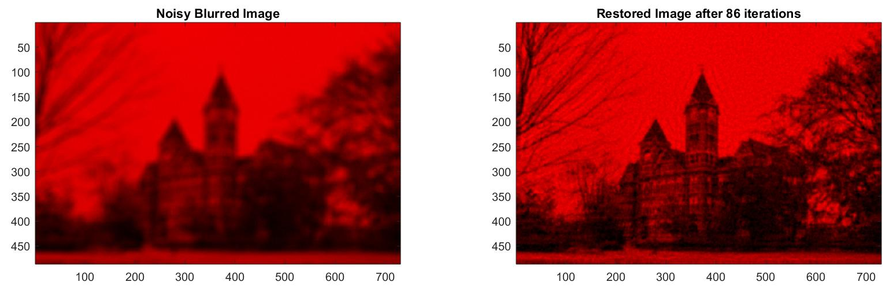
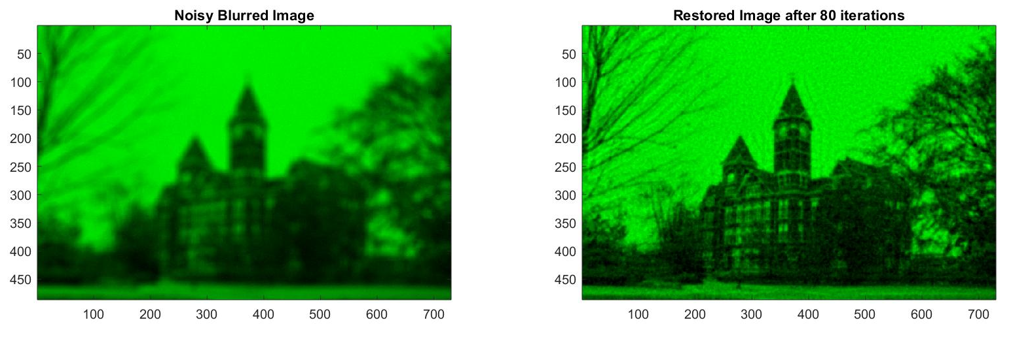
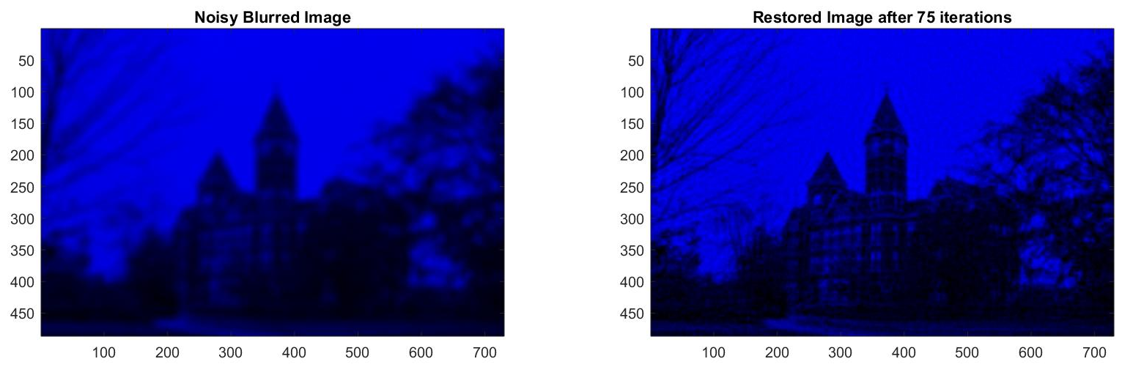
About 44 seconds of iterations…

Slide 14
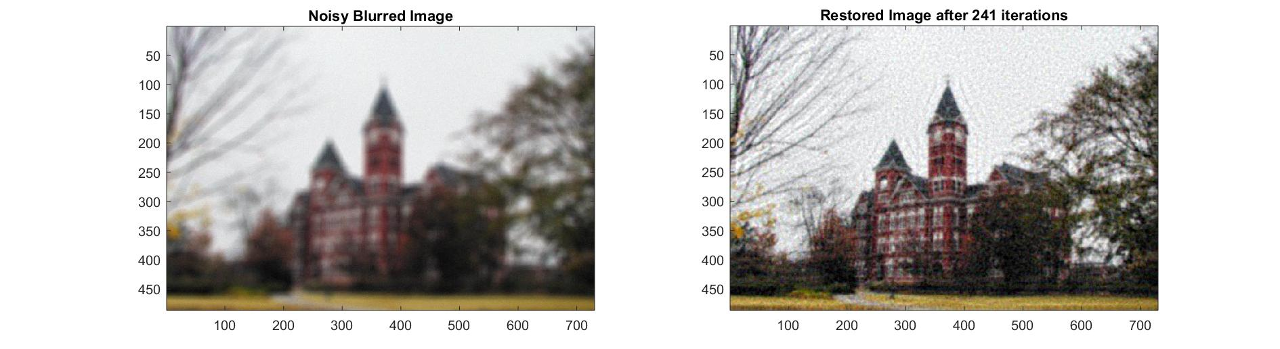
Out of Focus Blurred Result

Slide 15

Motion Blur

Slide 16
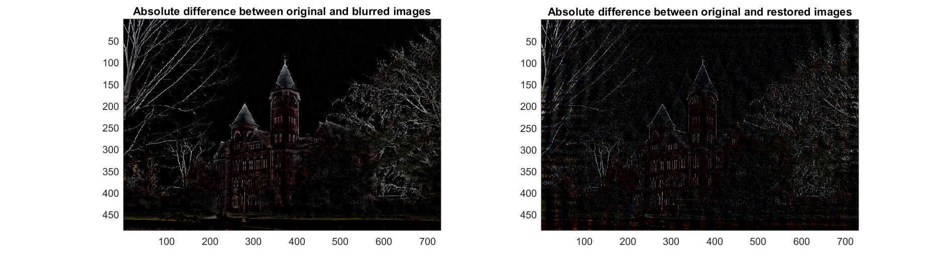
Quantifying The Improvement
Abs(Original-Blurred) | Abs(Original-Restored)
12.8978 | 11.6557
11.0415 | 9.8693
10.3372 | 9.4154

Slide 17
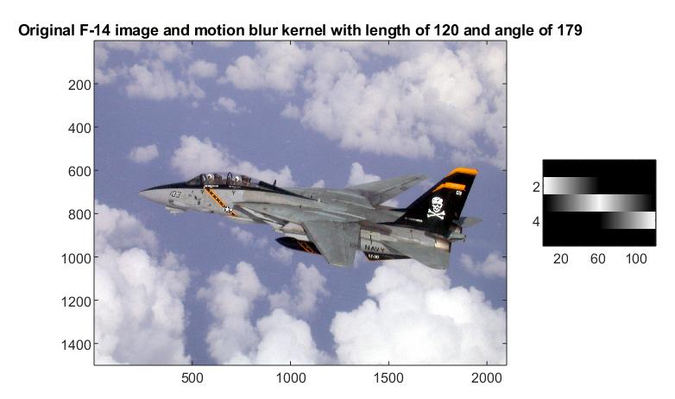
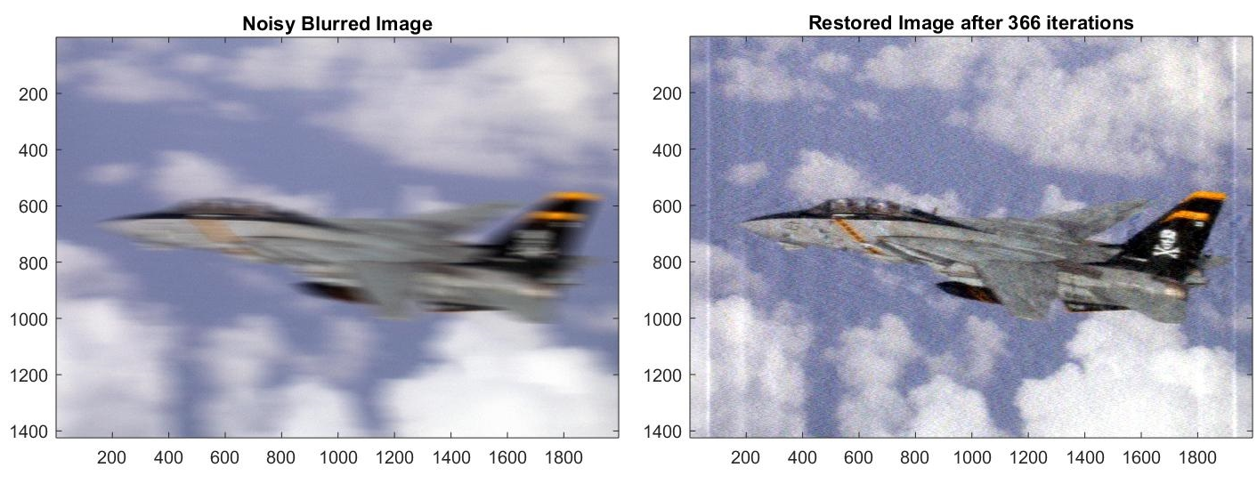
Motion Blurred F-14

Slide 18
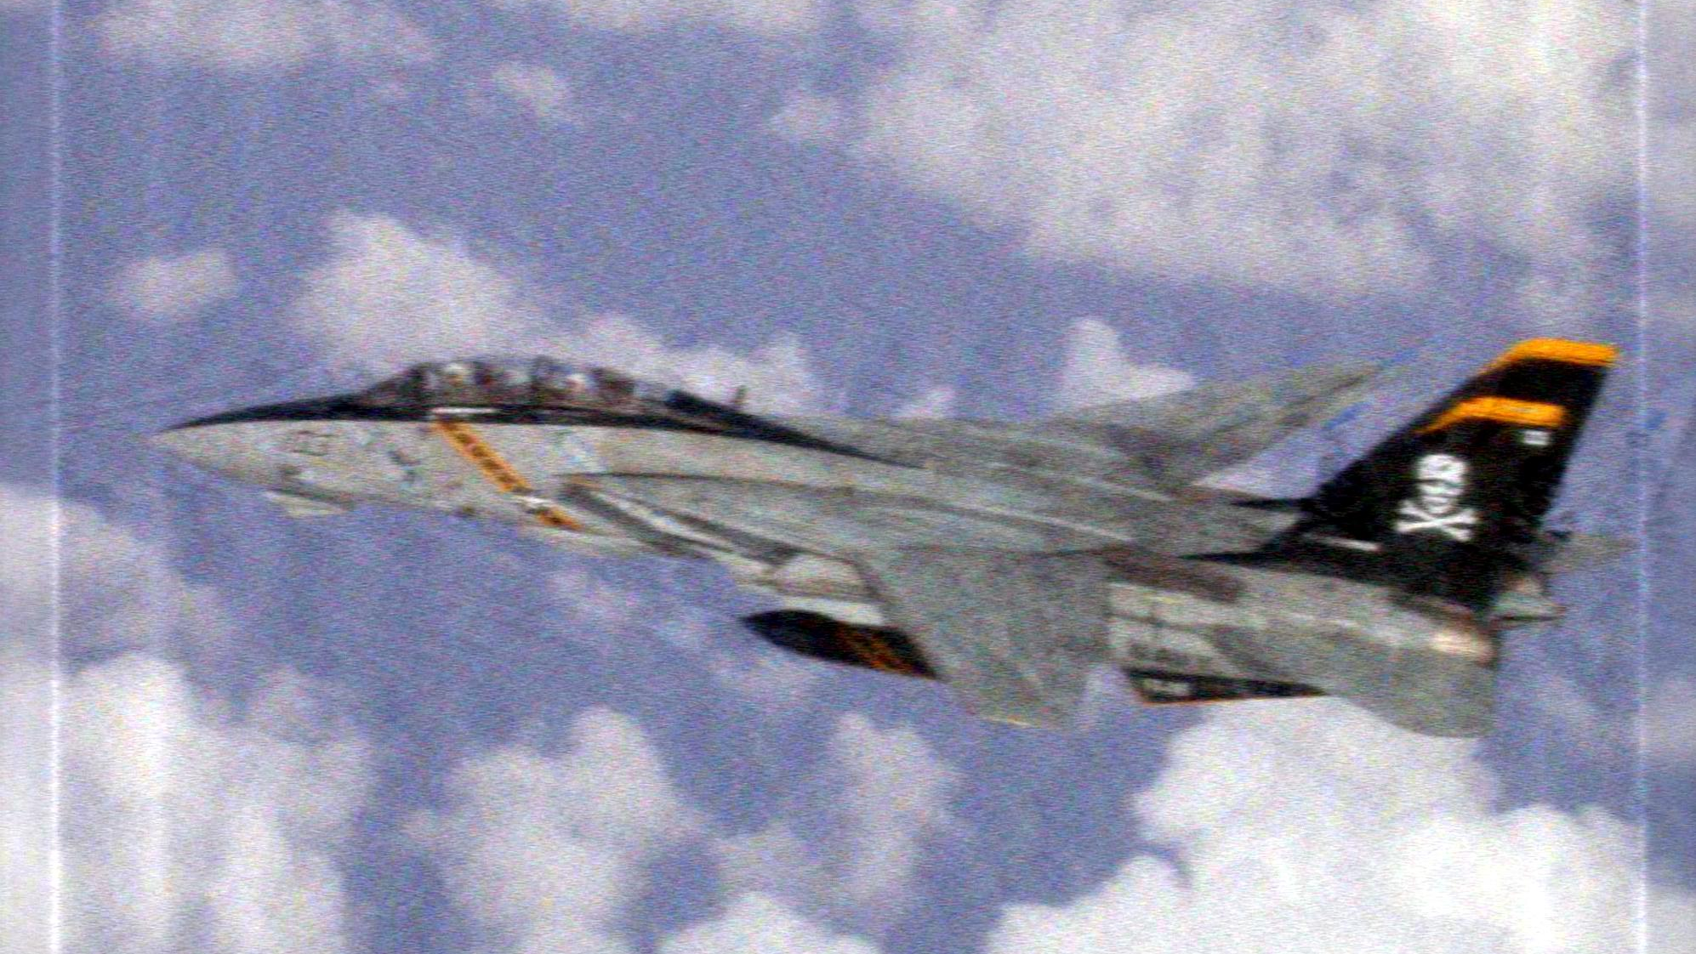
Motion Blurred F-14

Slide 19
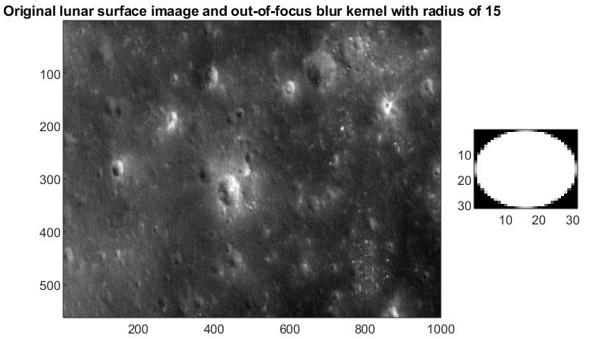
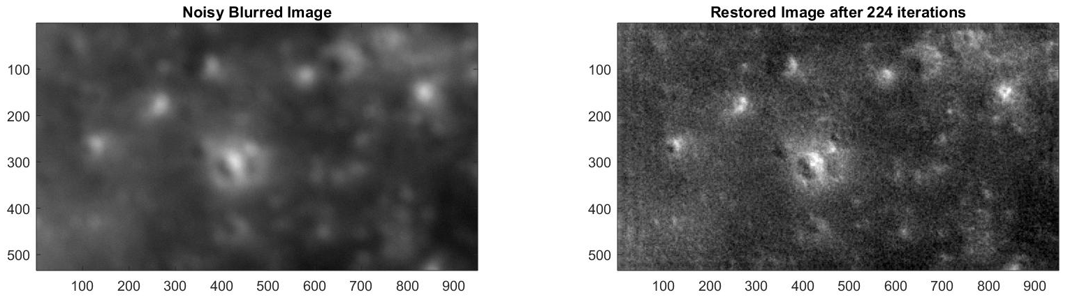
Out of Focus Blurred Lunar Surface

Slide 20
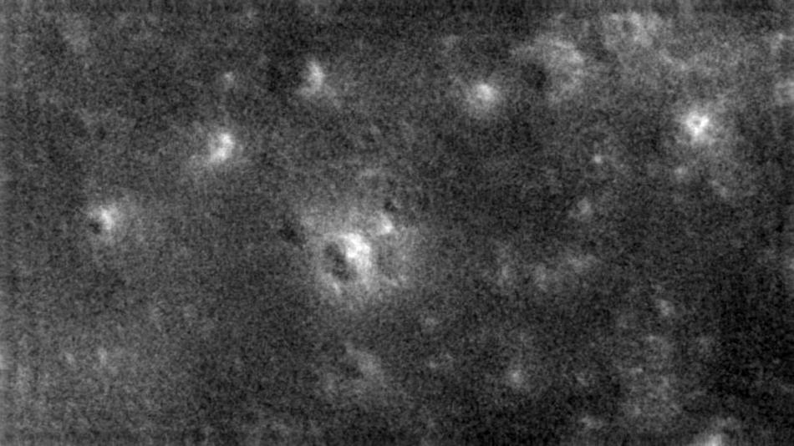
Out of Focus Blurred Lunar Surface

Slide 21
Summary
Total variation iterative deblurring is a very powerful technique for image restoration that is able to work even on noisy images
While there is room for improvement, this implementation is an effective tool that provides a user-friendly way to deblur images as long as information about the blurring kernel is known

Slide 22
Questions?

